Slide 1
Navigating Through Implementation Guide
Anagha Bhatkhande/Varsha Mahajan
V 01
Effective date: 26-Oct-2017Y
Copyright © 2016 Tata Consultancy Services Limited
Notes:
Title Slide
Theme Image area
We need to place appropriate image based on the content of the Presentation
Version No
Release date
PALS logo
TCS logo
Theme 1-a
Align text to the bottom of the logo bottom line
Font size 10pt

Slide 2


Confidentiality Statement
This document contains information which is commercially confidential to Tata Consultancy Services Ltd. ("TCS") and is provided for the sole purpose of permitting the recipient to evaluate the proposal submitted within the document. In consideration of the receipt of this document, the recipient agrees to maintain the information it contains in confidence and not to reproduce or otherwise disclose the contents of this document to any person outside the recipient's evaluation team or nominated advisors. The document may not be used, reproduced or disclosed to others, except as specifically permitted by TCS in writing. The recipient of this document, by its retention and use, agrees to take reasonable endeavours to protect the document and the information it contains from loss or theft.
© 2017 - TATA Consultancy Services Limited (TCS)
TCS confidential

Slide 3
About IG
SDTM IG guides the organizations on structure and format of standard clinical trial tabulation datasets.
These datasets are submitted to a regulatory authority such as the US Food and Drug Administration (FDA).
Current version of IG is 3.2
The SDTMIG should be used in close concert with the current version of the CDISC Study Data Tabulation Model (SDTM, available at http://www.cdisc.org/sdtm)

Slide 4
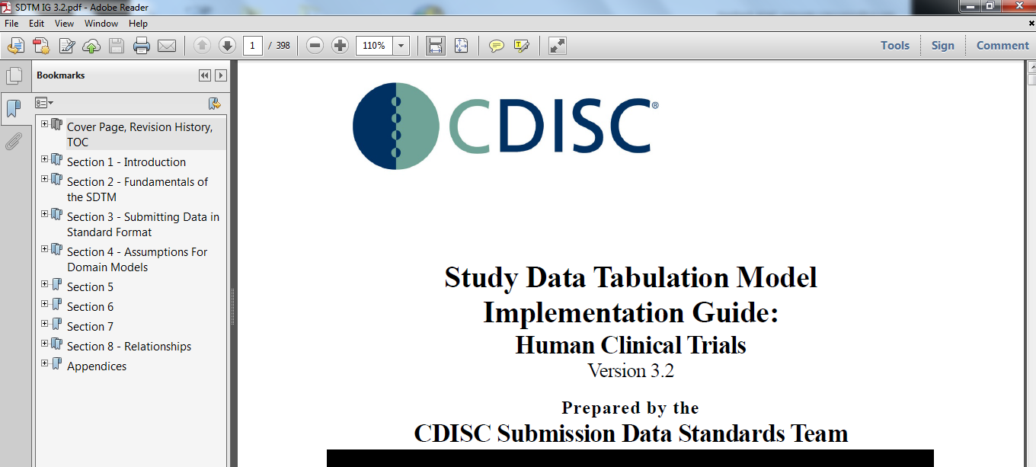
TCS Confidential

Slide 5
SDTM IG Sections
Section 1 Introduction:
Overall introduction
Describes changes from prior versions.
Section 2 Fundamentals of the SDTM
Basic concepts of the SDTM
How this implementation guide should be used in concert with the SDTM.
Section 3 – Submitting Data in Standard Format, explains how to describe metadata for regulatory submissions, and how to assess conformance with the standards.
Section 4 – Assumptions for Domain Models, describes basic concepts, business rules, and assumptions that should be taken into consideration before applying the domain models.
Section 5 – Models for Special-Purpose Domains, describes special-purpose domains, including Demographics, Comments, Subject Visits, and Subject Elements.
Section 6 – Domain Models Based on the General Observation Classes, provides specific metadata models based on the three general observation classes, along with assumptions and example data.
Section 7 – Trial Design Datasets, provides specific metadata models, assumptions, and examples.
Section 8 – Representing Relationships and Data, describes how to represent relationships between separate domains, datasets, and/or records, and information to help sponsors determine where data belongs in the SDTM.
Appendices provide additional background material and describe other supplemental material relevant to implementation.
TCS Confidential

Slide 6
Takeaway from EACH SECTION OF IG
Section | I will learn
1,2,3 | The key concepts for preparing domains and submitting data to regulatory authorities.
4 | What are the assumption while creating different domains
5 | Models for Special Purpose domains (You can refer back to Section 4 to link section 4 & 5) (implementation examples for each domain help to understand how to apply the domain models for specific types of data)
6 | Domain Models based on General Observation classes (implementation examples for each domain help to understand how to apply the domain models for specific types of data)
7 | Trial Design Domains to understand the fundamentals of the Trial Design Model
8 | Representing Relationships and Data helps to understand how to express relationships between datasets, records and additional variables not specifically defined in the models.
Appendices | Appendix C – Controlled Terminology, in particular, describes how CDISC Terminology is centrally managed by the CDISC Controlled Terminology Team. CDISC terminology is updated on a quarterly

Slide 7
Reference PAPER

Slide 8
Thank You
For any feedback/comment/clarification please contact us at PALS@tcs.com
V NN

Slide 9
Document Release Notice
This XXXXXXX, Version NN, is released for use in Tata Consultancy Services (TCS) with effect from – DD-Mmm-YYYY.
This Training Material is subject to TCS Document Control Procedure. TCS reserves the right to make additions, modifications or alterations to the existing content or release a newer version of this document.
Softcopy of the latest version of the document is available in the ABCDEFG
Comments suggestions or queries should be addressed to PALS@tcs.com.
Date: DD-Mmm-YYYY
Date: DD-Mmm-YYYY
Document Name
Effective Date: DD-MMM-YYYY
V NN
Notes:
Font size 9pt

Slide 10
Change/Revision History
Version No. | Revision Description | Slide No. | Rationale for the Change | Change type (Add/Modify/Delete) | Modified By | Date Modified (DD-Mmm-YYYY)
V NN

